Slide 1
IRENE CAI
Turtle is listening to you……

Slide 2
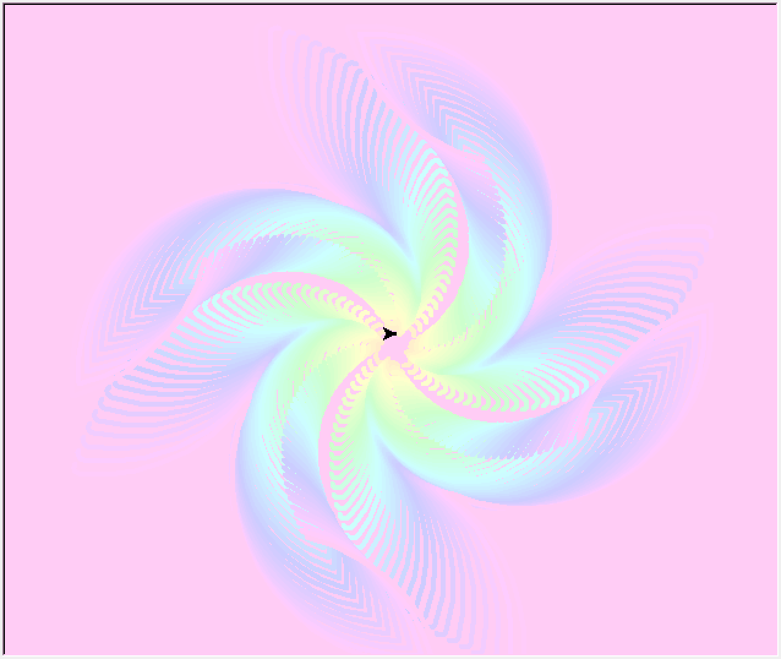
What is it?
It is a program that change English sentences into moving images.

Slide 3
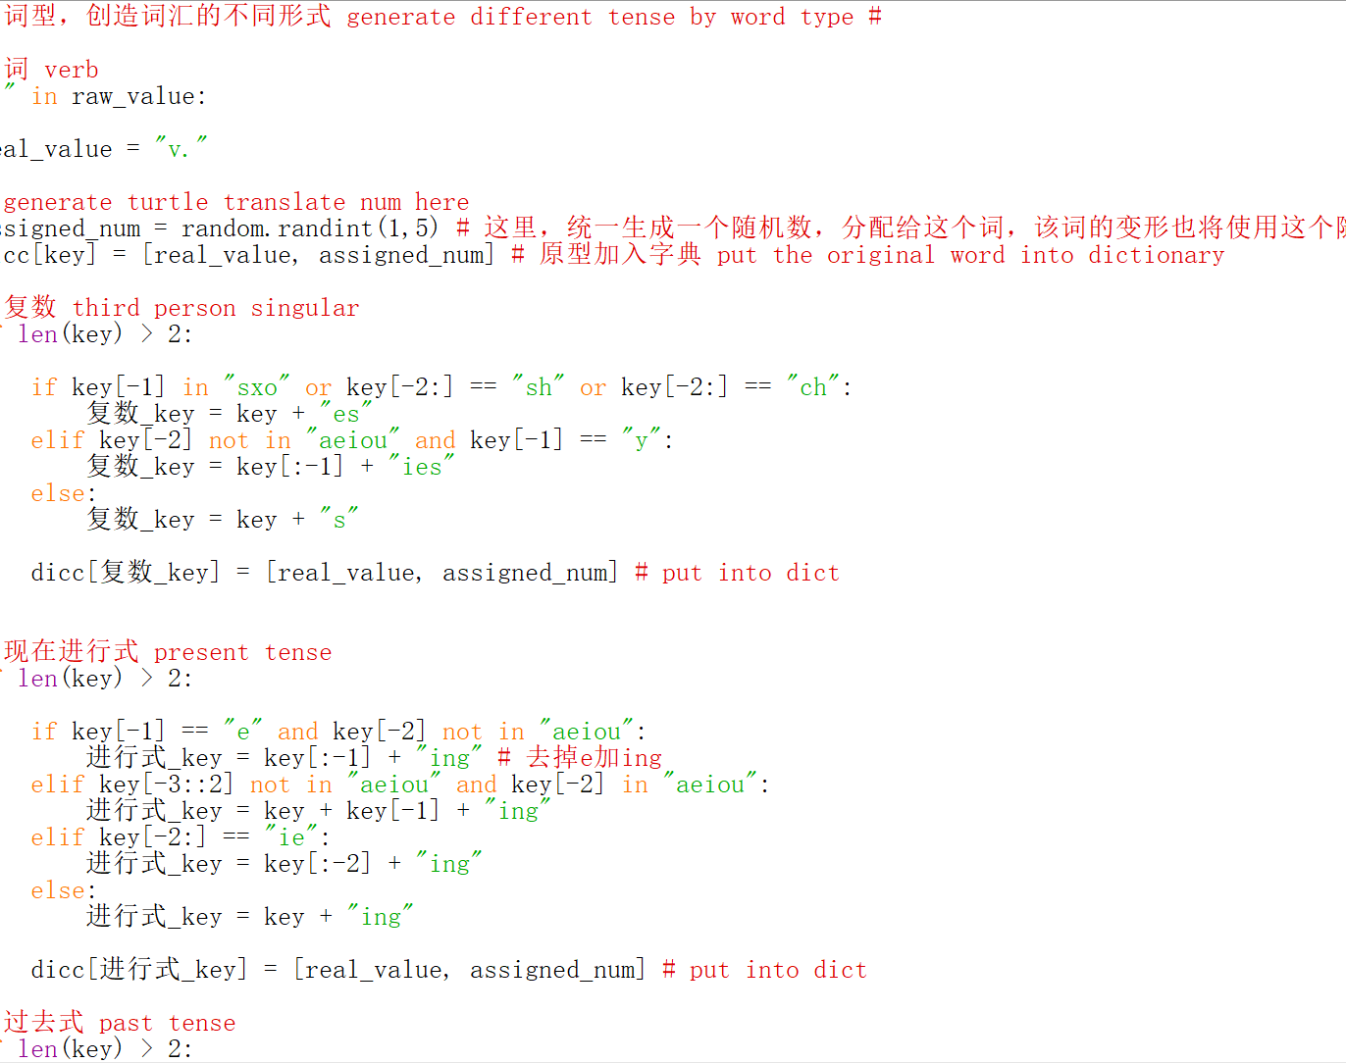
Make a dictionary
1.Oxford Dictionary
2.“make” / “making” ?
3.Store it.

Slide 4
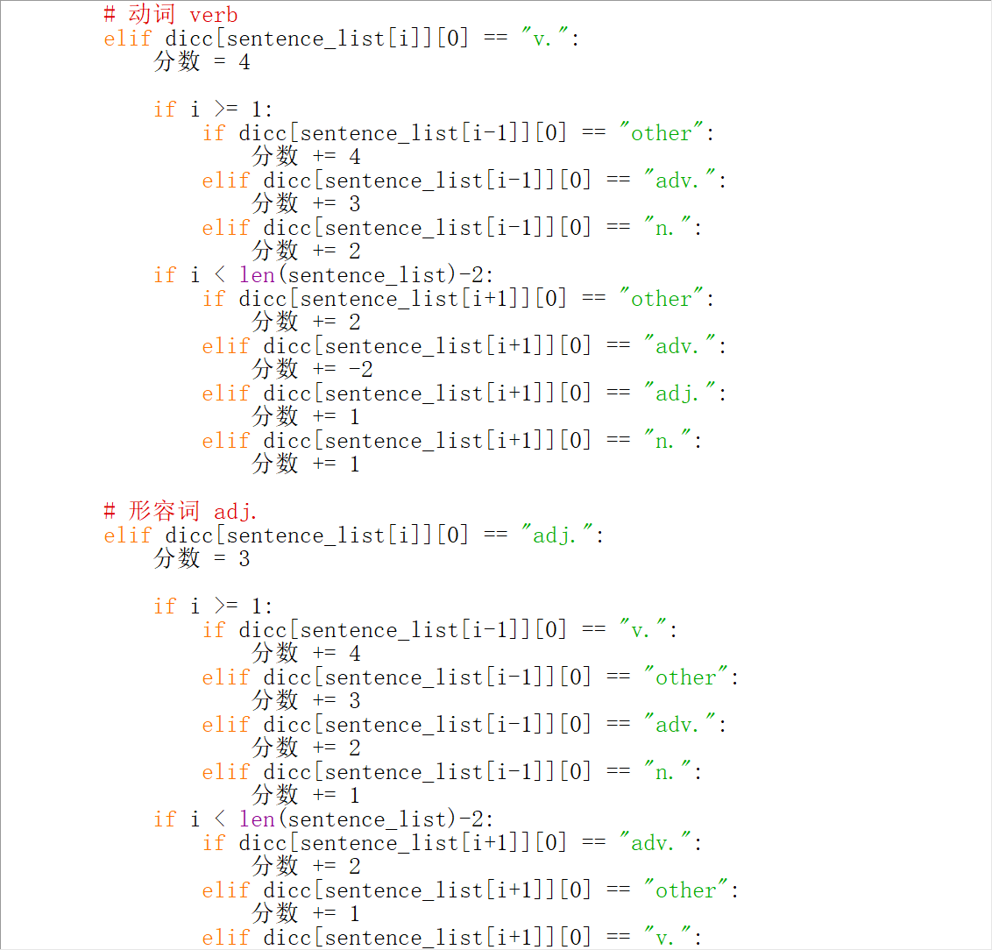
Input and translate
~ Give each word a weight
~ the top one decide the drawing
~ and parameter as well

Slide 5
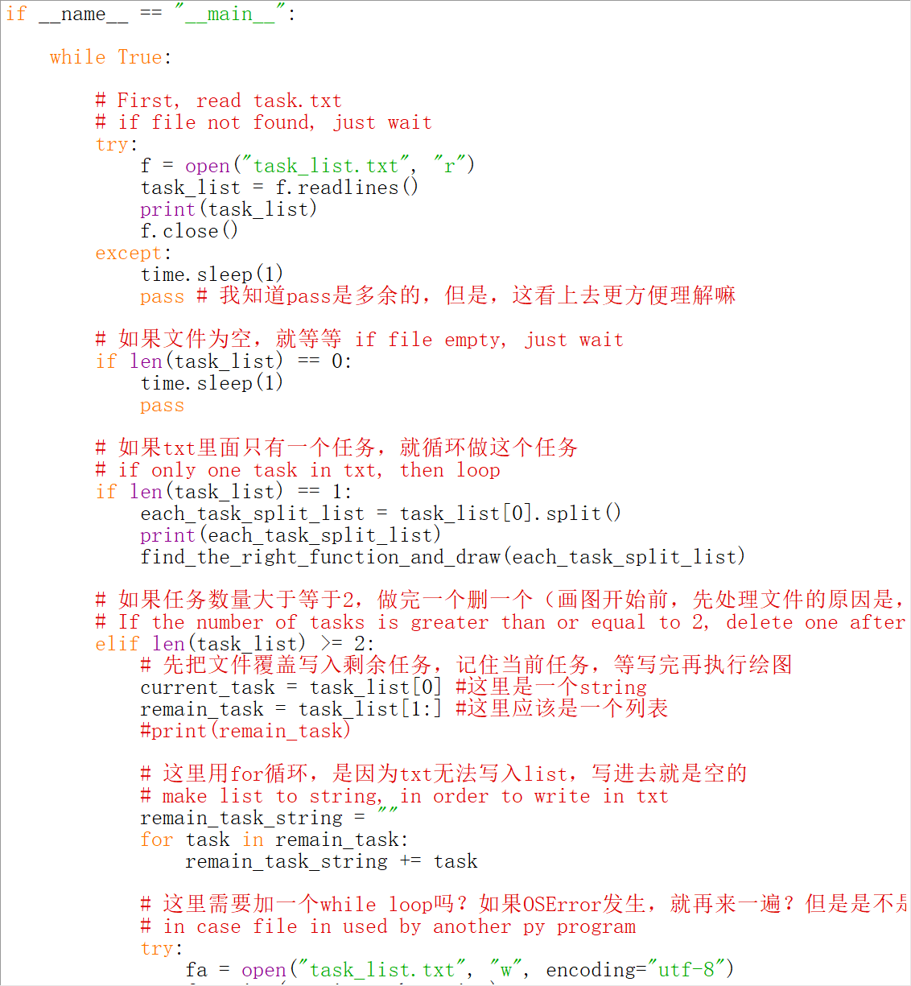
then DRAW it
~ but, what if I don’t want to stop user inputing more?
~ enjoy!!!

Slide 6
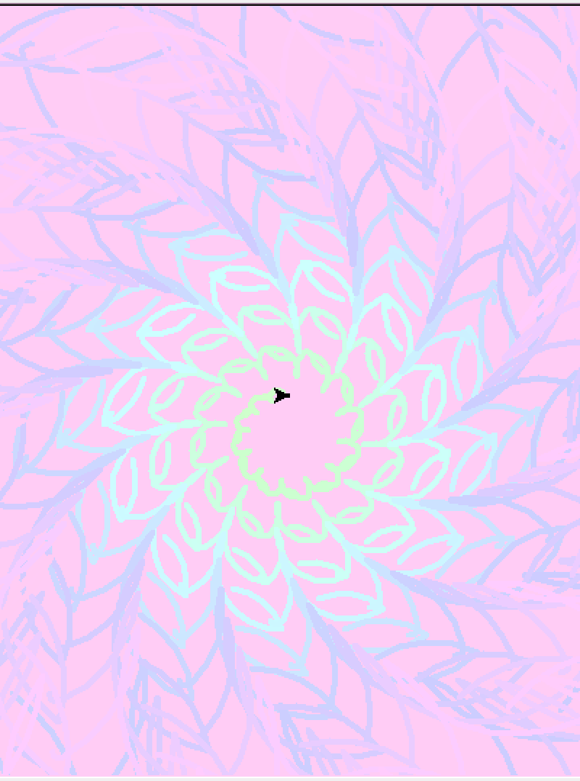
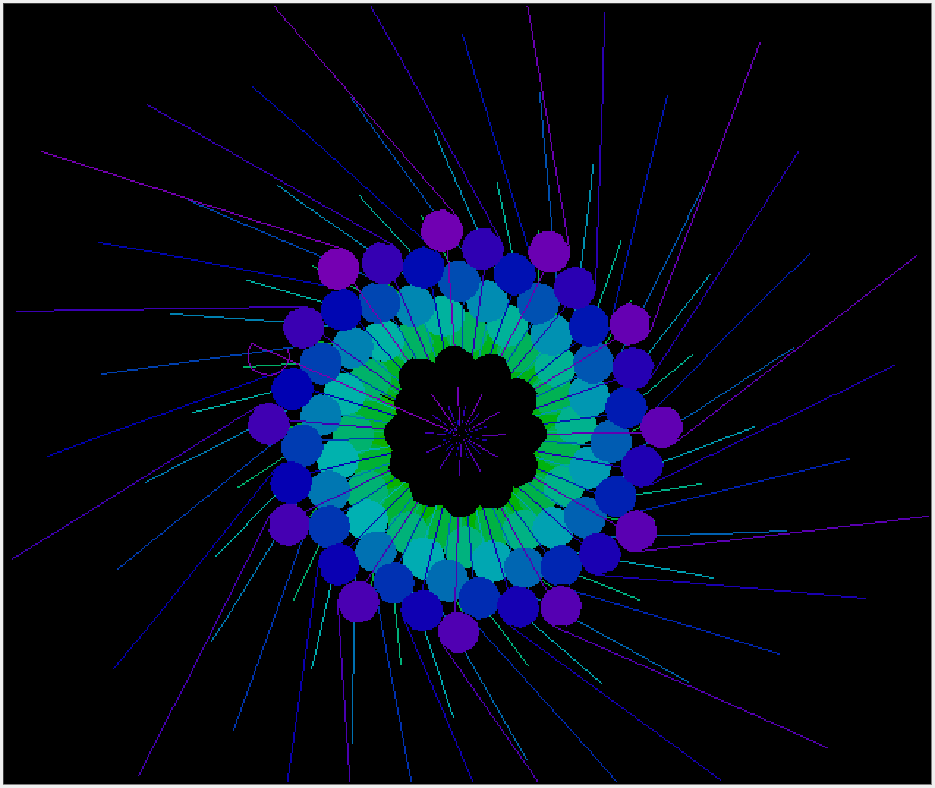

Slide 7
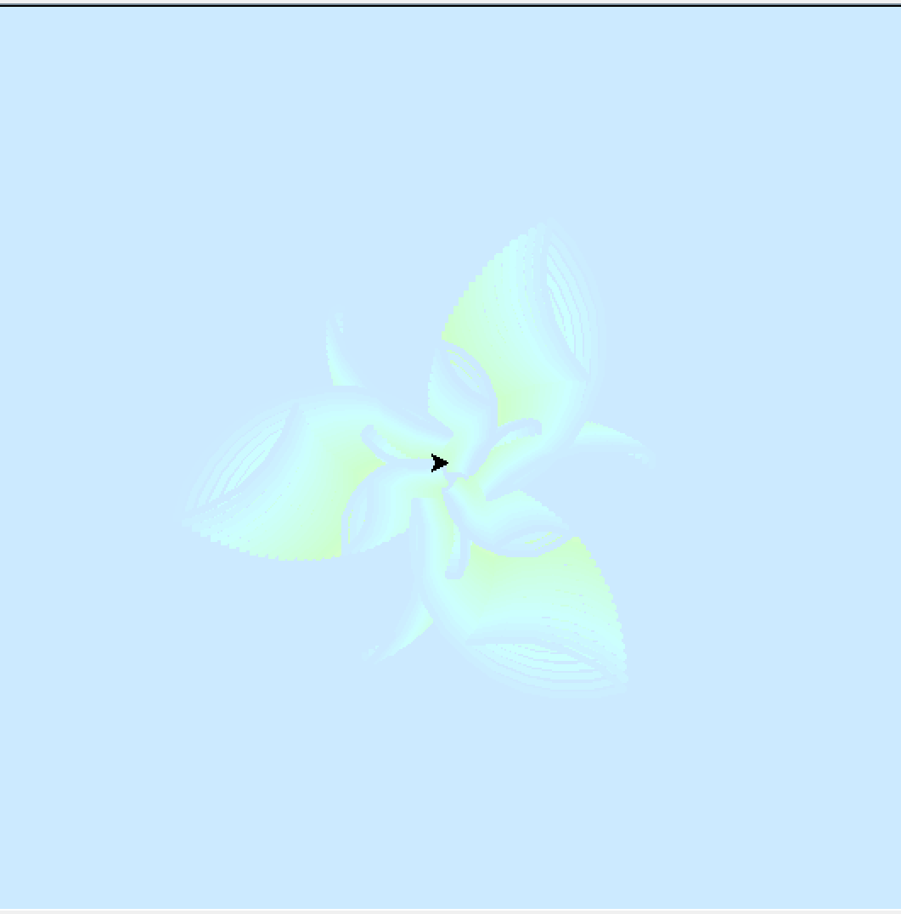
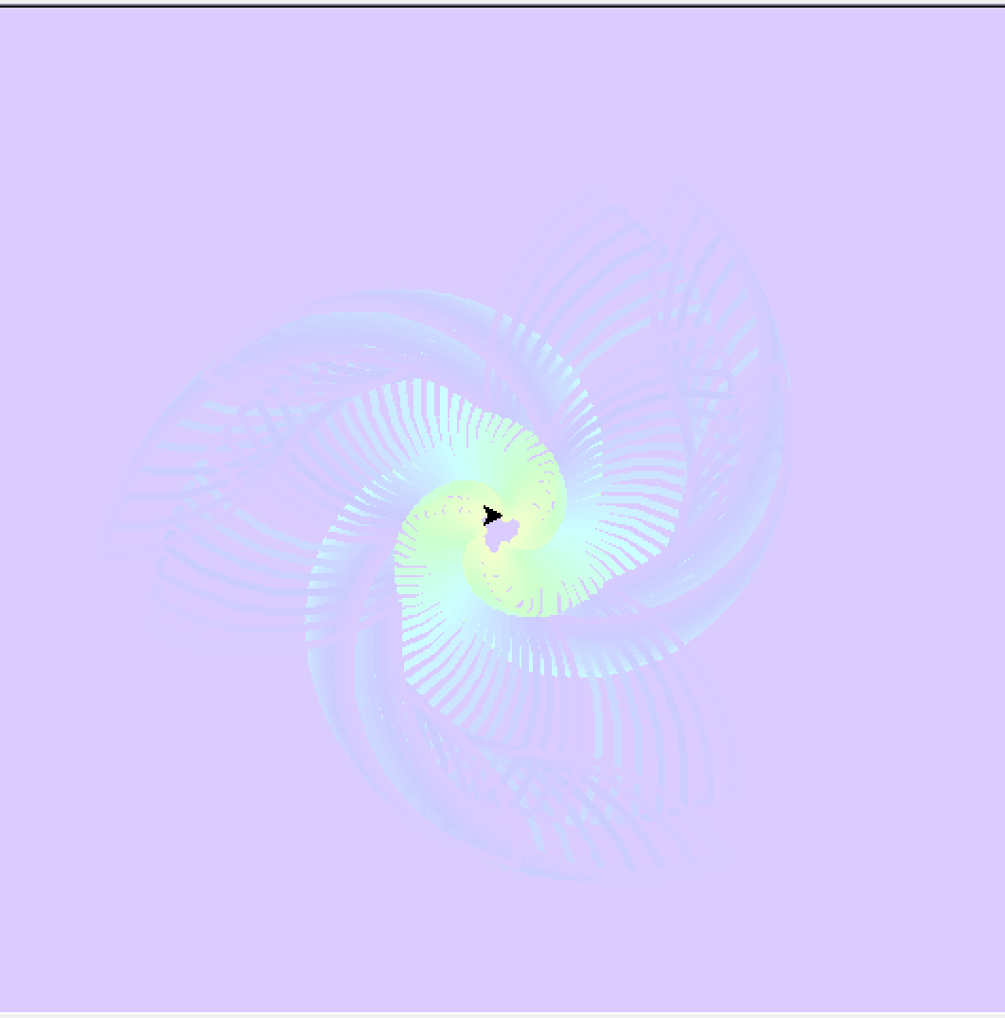

Slide 8
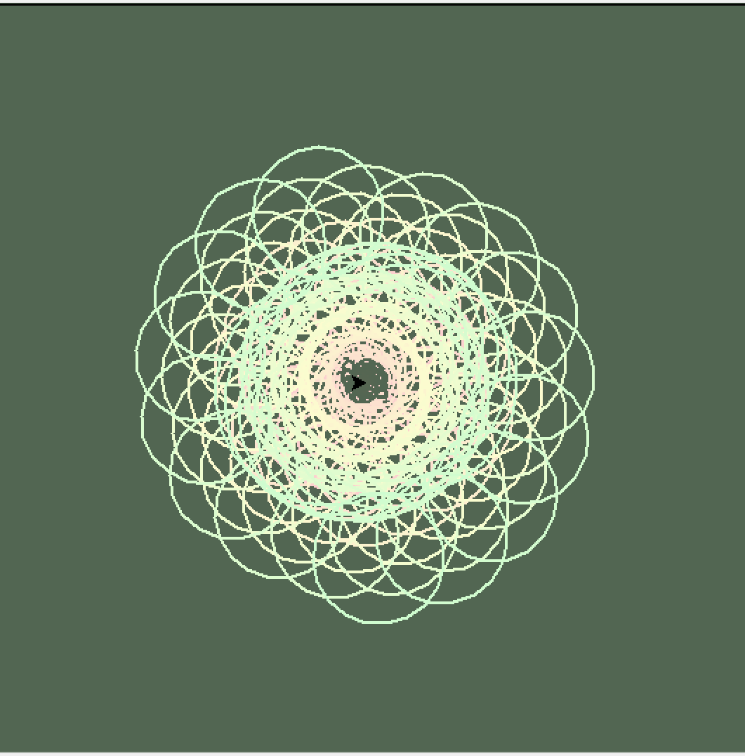
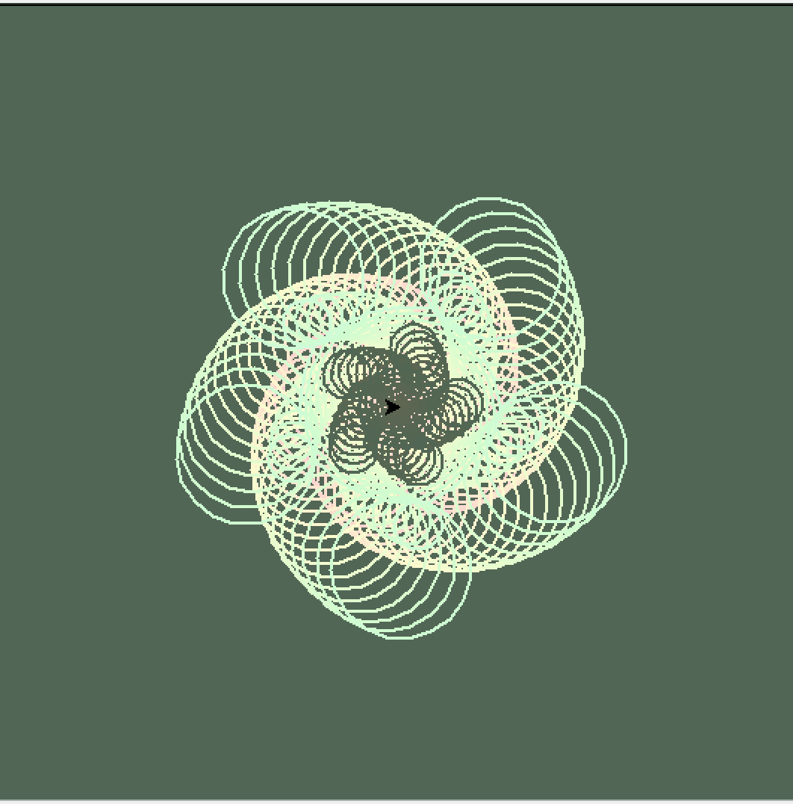

Slide 9
Citation(unformal):
~ Turtle
https://docs.python.org/zh-cn/3/library/turtle.html
~ colorsys
https://docs.python.org/3/library/colorsys.html
~ json
https://docs.python.org/3/library/json.html
~ ramdom
https://docs.python.org/3/library/random.html
~ collections
https://docs.python.org/3/library/collections.html
~ time
https://docs.python.org/3/library/time.html

